Slide 1



Data Challenge DS&AI 2nd year
Spotify
Top 2000 songs 1999-2019
Georgiy Farina
Enkh-Oyu Nomin

Slide 2



Data Challenge
Spotify top 2000 songs
Client requirements
Client requirements
Explore and analyse the Top 2000 songs on Spotify between the year 1999 and 2019
Dataset
Research questions:
Most consistent artists throughout the years?
Average popularity of those artists?
Most present and popular genres?
Top 10 songs?
Valence of the top 10 songs?
Duration of the songs throughout the years?
Any correlation between popularity and other features?
Data Cleaning
Exploratory analysis
“Popularity” prediction
“Explicit” prediction
Build two models that are able to:
Summary of results
Predict the estimated popularity of a song
Predicting whether a song is explicit or not
Notes:
We were both client and data scientists team

Slide 3


Data Challenge
Spotify top 2000 songs
Data Challenge
Spotify top 2000 songs
Dataset
About Us
Client requirements
Kaggle dataset containing 2000 songs x 18 features
Our Album
Main features involved in data analysis:
Dataset
Playlist
Feature name | Description | Values domain
artist | Name of the artist / band | -
song | Name of the song | -
duration_ms | Duration in milliseconds | -
explicit | Indicates if a song is explicit or not | False / True
year | Release year of the song | -
popularity | Popularity of the song | From 0 to 100
valence | Musical positiveness | From 0 to 1
genre | Genre(s) of the song | More than 1 allowed
Data Cleaning
Artists
Exploratory analysis
Podcasts & Shows
“Popularity” prediction
Your Library
“Explicit” prediction
Trending
Summary of results
Help
Report History
Notes:
Originally our dataset consists of 18 columns & 2000 rows, roughly 100 for each year. The following features are the main ones involved in our data analysis:

Slide 4
Data Challenge
Spotify top 2000 songs
Data Cleaning
Data Challenge
Spotify top 2000 songs
Data Challenge
Spotify top 2000 songs
About Us
0 null values
Ambiguous «set()» value in genre column
No interpretability available → 22 rows removed
59 duplicate rows removed
1998 and 2020 year rows removed (outliers)
1 song for 1998, 3 songs for 2020
Rescaled some features for visualization purposes
Explicit column converted from FALSE | TRUE to 0 | 1
Genre column split into multiple columns (13 different genres)
1 for each genre, binary value
Final shape: 1915 songs with 31 features
About Us
Client requirements
Our Album
Our Album
Dataset
Playlist
Playlist
Data Cleaning
Artists
Artists
Exploratory analysis
Podcasts & Shows
Podcasts & Shows
“Popularity” prediction
Your Library
Your Library
“Explicit” prediction
Trending
Trending
Summary of results
Help
Help
Report History
Report History
Notes:
1998 and 2020 songs removed because they could later on potentially affect the models accuracies
Rescaled because some features were supposed to be from 0-100 or 0-1, but the highest values were 89 or 0.75. To visualize better, we rescale (NOT STANDARDIZED OR NORMALIZED, just rescaled)

Slide 5
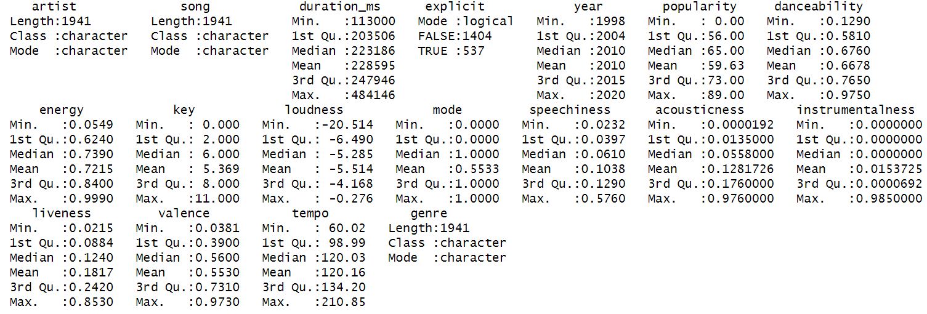
Data Challenge
Spotify top 2000 songs
Data Challenge
Spotify top 2000 songs
Data Challenge
Spotify top 2000 songs
Data Challenge
Spotify top 2000 songs
Exploratory analysis
Summary statistics
About Us
About Us
About Us
Client requirements
Our Album
Our Album
Our Album
Dataset
Playlist
Playlist
Playlist
Data Cleaning
Artists
Artists
Artists
Exploratory analysis
Podcasts & Shows
Podcasts & Shows
Podcasts & Shows
“Popularity” prediction
Your Library
Your Library
Your Library
“Explicit” prediction
Trending
Trending
Trending
Summary of results
Help
Help
Help
Report History
Report History
Report History

Slide 6
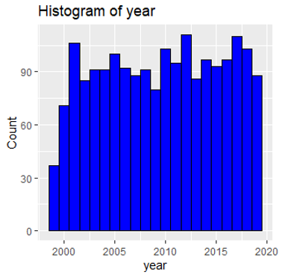
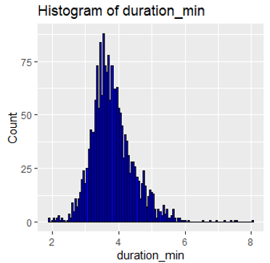
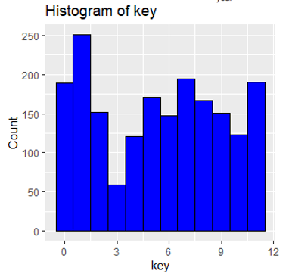
Data Challenge
Spotify top 2000 songs
Data Challenge
Spotify top 2000 songs
Data Challenge
Spotify top 2000 songs
Data Challenge
Spotify top 2000 songs
Exploratory analysis
Data distribution
About Us
About Us
About Us
Client requirements
Our Album
Our Album
Our Album
Dataset
Songs per year and the key of the songs spread out homogeneously
Duration in minutes follows a “normal” distribution
Playlist
Playlist
Playlist
Data Cleaning
Artists
Artists
Artists
Exploratory analysis
Podcasts & Shows
Podcasts & Shows
Podcasts & Shows
“Popularity” prediction
Your Library
Your Library
Your Library
“Explicit” prediction
Trending
Trending
Trending
Summary of results
Help
Help
Help
Report History
Report History
Report History

Slide 7
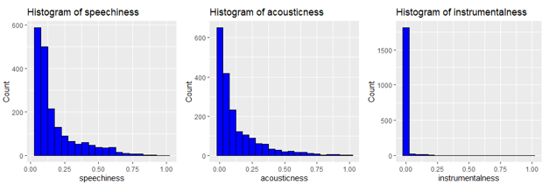
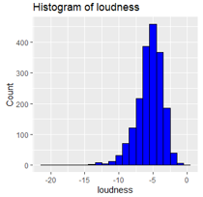
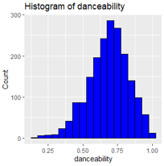
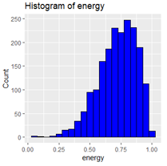
Data Challenge
Spotify top 2000 songs
Data Challenge
Spotify top 2000 songs
Data Challenge
Spotify top 2000 songs
Data Challenge
Spotify top 2000 songs
Exploratory analysis
Data distribution
About Us
About Us
About Us
Client requirements
Our Album
Our Album
Our Album
Dataset
Playlist
Playlist
Playlist
Data Cleaning
Right skewed
Artists
Artists
Artists
Exploratory analysis
Podcasts & Shows
Podcasts & Shows
Podcasts & Shows
“Popularity” prediction
Your Library
Your Library
Your Library
“Explicit” prediction
Trending
Trending
Trending
Summary of results
Left skewed
Help
Help
Help
Report History
Report History
Report History

Slide 8
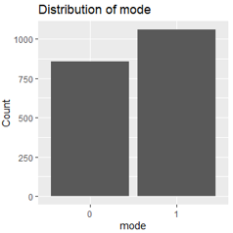
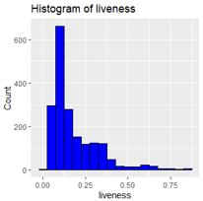
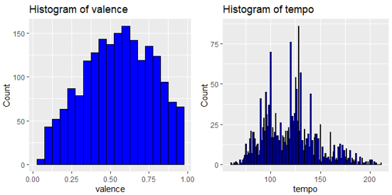
Data Challenge
Spotify top 2000 songs
Data Challenge
Spotify top 2000 songs
Data Challenge
Spotify top 2000 songs
Data Challenge
Spotify top 2000 songs
Exploratory analysis
Data distribution
About Us
About Us
About Us
Client requirements
Our Album
Our Album
Our Album
Dataset
Playlist
Valence and tempo «normal» distributions
Liveness right skewed
Mode «balanced»
Playlist
Playlist
Data Cleaning
Artists
Artists
Artists
Exploratory analysis
Podcasts & Shows
Podcasts & Shows
Podcasts & Shows
“Popularity” prediction
Your Library
Your Library
Your Library
“Explicit” prediction
Trending
Trending
Trending
Summary of results
Help
Help
Help
Report History
Report History
Report History

Slide 9
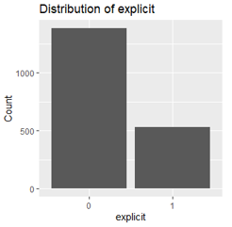
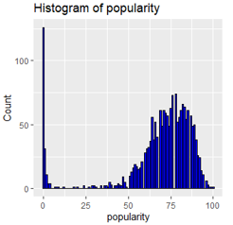
Data Challenge
Spotify top 2000 songs
Data Challenge
Spotify top 2000 songs
Data Challenge
Spotify top 2000 songs
Data Challenge
Spotify top 2000 songs
Exploratory analysis
Data distribution
About Us
About Us
About Us
Client requirements
Our Album
Our Album
Our Album
Dataset
Explicit target for classification: highly unbalanced
Popularity with many outliers, without those resembles Gaussian
Playlist
Playlist
Playlist
Data Cleaning
Artists
Artists
Artists
Exploratory analysis
Podcasts & Shows
Podcasts & Shows
Podcasts & Shows
“Popularity” prediction
Your Library
Your Library
Your Library
“Explicit” prediction
Trending
Trending
Trending
Summary of results
Help
Help
Help
Report History
Report History
Report History

Slide 10
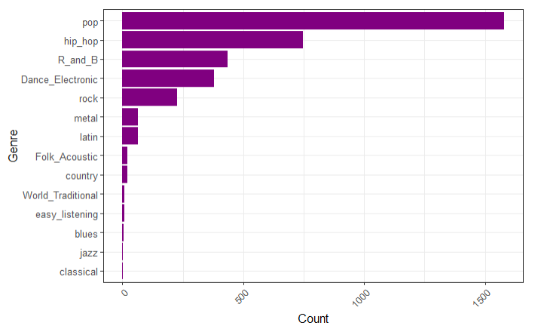
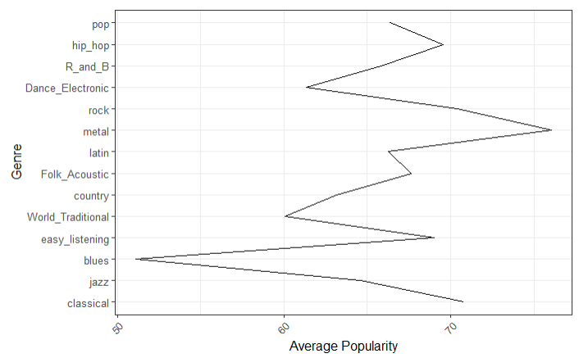
Exploratory analysis
Genre count
VS
Genre avg popularity
Data Challenge
Spotify top 2000 songs
Data Challenge
Spotify top 2000 songs
Data Challenge
Spotify top 2000 songs
Data Challenge
Spotify top 2000 songs
About Us
About Us
About Us
Client requirements
Our Album
Our Album
Our Album
Dataset
Playlist
Playlist
Playlist
Data Cleaning
Artists
Artists
Artists
Exploratory analysis
Podcasts & Shows
Podcasts & Shows
Podcasts & Shows
“Popularity” prediction
Your Library
Your Library
Your Library
“Explicit” prediction
Trending
Trending
Trending
Summary of results
Help
Help
Help
Report History
Report History
Report History

Slide 11
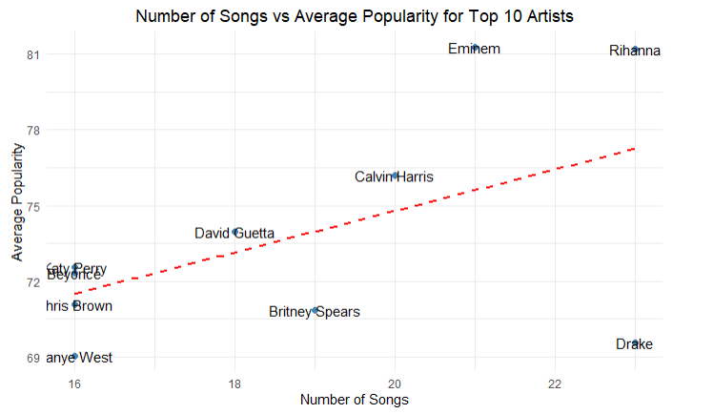
Exploratory analysis
Top 10 Artists count
VS
Top 10 Artists avg popularity
Data Challenge
Spotify top 2000 songs
Data Challenge
Spotify top 2000 songs
Data Challenge
Spotify top 2000 songs
Data Challenge
Spotify top 2000 songs
About Us
About Us
About Us
Client requirements
Our Album
Our Album
Our Album
Dataset
Playlist
Playlist
Playlist
Data Cleaning
Artists
Artists
Artists
Exploratory analysis
Podcasts & Shows
Podcasts & Shows
Podcasts & Shows
“Popularity” prediction
Your Library
Your Library
Your Library
“Explicit” prediction
Trending
Trending
Trending
Summary of results
Help
Help
Help
Report History
Report History
Report History

Slide 12
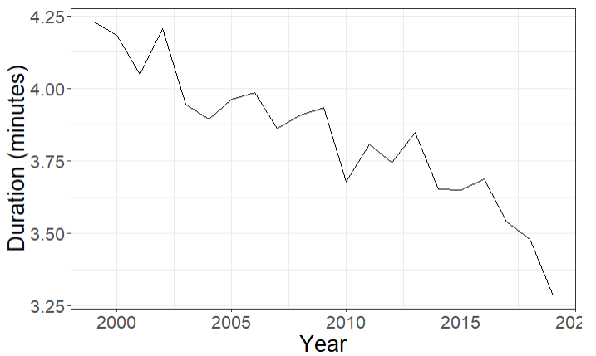
Exploratory analysis
Duration throughout the years
Data Challenge
Spotify top 2000 songs
Data Challenge
Spotify top 2000 songs
Data Challenge
Spotify top 2000 songs
Data Challenge
Spotify top 2000 songs
About Us
About Us
About Us
Client requirements
Our Album
Our Album
Our Album
Dataset
Playlist
Playlist
Playlist
Data Cleaning
Artists
Artists
Artists
Exploratory analysis
Podcasts & Shows
Podcasts & Shows
Podcasts & Shows
“Popularity” prediction
Your Library
Your Library
Your Library
“Explicit” prediction
Trending
Trending
Trending
Summary of results
Help
Help
Help
Report History
Report History
Report History

Slide 13
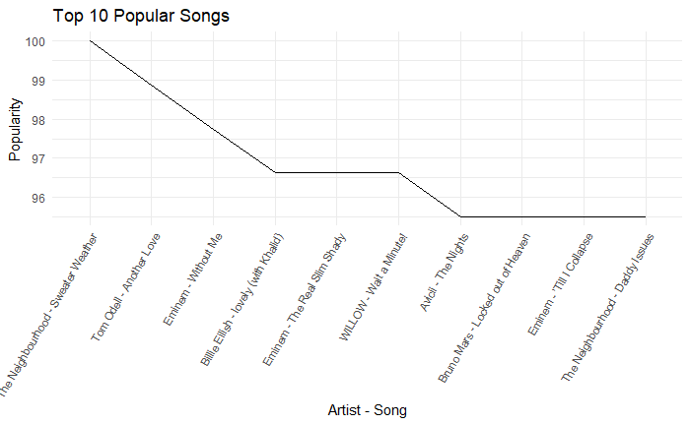
Exploratory analysis
Top 10 popular songs
Data Challenge
Spotify top 2000 songs
Data Challenge
Spotify top 2000 songs
Data Challenge
Spotify top 2000 songs
Data Challenge
Spotify top 2000 songs
About Us
About Us
About Us
Client requirements
Our Album
Our Album
Our Album
Dataset
Playlist
Playlist
Playlist
Data Cleaning
Artists
Artists
Artists
Exploratory analysis
Podcasts & Shows
Podcasts & Shows
Podcasts & Shows
“Popularity” prediction
Your Library
Your Library
Your Library
“Explicit” prediction
Trending
Trending
Trending
Summary of results
Help
Help
Help
Report History
Report History
Report History

Slide 14
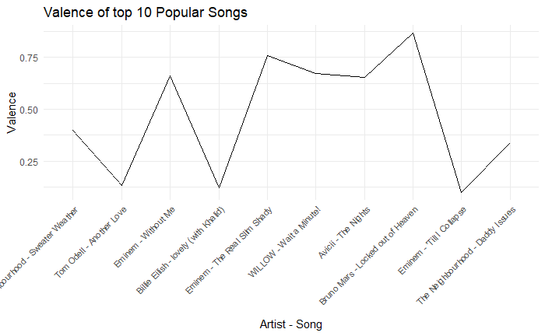
Exploratory analysis
Top 10 popular songs valence
Data Challenge
Spotify top 2000 songs
Data Challenge
Spotify top 2000 songs
Data Challenge
Spotify top 2000 songs
Data Challenge
Spotify top 2000 songs
About Us
About Us
About Us
Client requirements
Our Album
Our Album
Our Album
Dataset
Playlist
Playlist
Playlist
Data Cleaning
Artists
Artists
Artists
Exploratory analysis
Podcasts & Shows
Podcasts & Shows
Podcasts & Shows
“Popularity” prediction
Your Library
Your Library
Your Library
“Explicit” prediction
Trending
Trending
Trending
Summary of results
Help
Help
Help
Report History
Report History
Report History

Slide 15
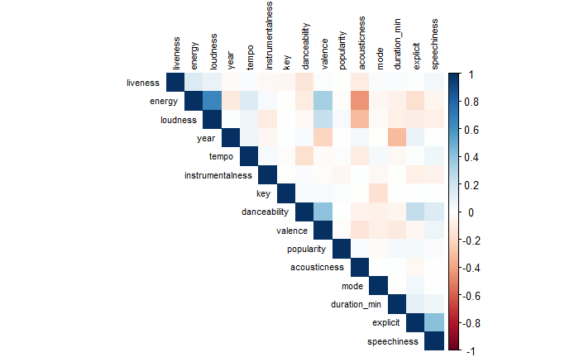
Exploratory analysis
Correlation matrix
Data Challenge
Spotify top 2000 songs
Data Challenge
Spotify top 2000 songs
Data Challenge
Spotify top 2000 songs
Data Challenge
Spotify top 2000 songs
About Us
About Us
About Us
Client requirements
Our Album
Our Album
Our Album
Dataset
Playlist
Playlist
Playlist
Data Cleaning
Popularity has no correlations
Main ones between acoustic features (predictors)
Artists
Artists
Artists
Exploratory analysis
Podcasts & Shows
Podcasts & Shows
Podcasts & Shows
“Popularity” prediction
Your Library
Your Library
Your Library
“Explicit” prediction
Trending
Trending
Trending
Summary of results
Help
Help
Help
Report History
Report History
Report History

Slide 16
Data Challenge
Spotify top 2000 songs
Data Challenge
Spotify top 2000 songs
Data Challenge
Spotify top 2000 songs
Data Challenge
Spotify top 2000 songs
Exploratory analysis
Choice of the models
About Us
About Us
About Us
Client requirements
Our Album
Our Album
Our Album
Dataset
Playlist
Playlist
Playlist
Popularity:
Linear Regression: simple but can be effective,
even though popularity has no correlations
Lasso Regression: distributes weights and performs a «feature selection»
Ridge Regression: useful with linear relations between predictors
Decision Tree Regression / Random Forest Regression: non-linear relationships
Explicit:
Logistic Regression: provides probabilities + interpretability
Linear Discriminant Analysis: computationally efficient + interpretability
Random Forest Classification: usually efficient + non-linear relationships
Data Cleaning
Artists
Artists
Artists
Exploratory analysis
Podcasts & Shows
Podcasts & Shows
Podcasts & Shows
“Popularity” prediction
Your Library
Your Library
Your Library
“Explicit” prediction
Trending
Trending
Trending
Summary of results
Help
Help
Help
Report History
Report History
Report History

Slide 17
Data Challenge
Spotify top 2000 songs
Data Challenge
Spotify top 2000 songs
Data Challenge
Spotify top 2000 songs
Data Challenge
Spotify top 2000 songs
“Popularity” prediction
Pre-processing for regression task
About Us
About Us
About Us
Client requirements
Our Album
Our Album
Our Album
Dataset
Playlist
Playlist
Playlist
Standardization of numerical data
Removed categorical columns “artist” & “song”
Removed the data having popularity’s outliers
Didn’t remove all outliers → training data left with approx. 450-500 rows
75/25 – train/test
Data Cleaning
Artists
Artists
Artists
Exploratory analysis
Podcasts & Shows
Podcasts & Shows
Podcasts & Shows
“Popularity” prediction
Your Library
Your Library
Your Library
“Explicit” prediction
Trending
Trending
Trending
Summary of results
Help
Help
Help
Report History
Report History
Report History

Slide 18
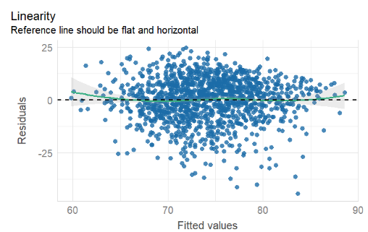
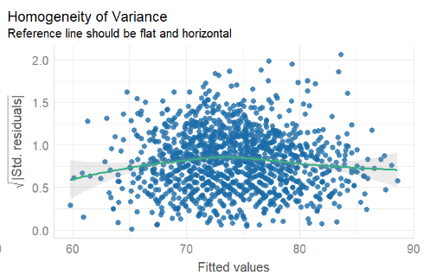
Data Challenge
Spotify top 2000 songs
Data Challenge
Spotify top 2000 songs
Data Challenge
Spotify top 2000 songs
Data Challenge
Spotify top 2000 songs
“Popularity” prediction
Linear Regression
About Us
About Us
About Us
Client requirements
Our Album
Our Album
Our Album
Dataset
Playlist
Playlist
Playlist
Data Cleaning
Artists
Artists
Artists
Exploratory analysis
Podcasts & Shows
Podcasts & Shows
Podcasts & Shows
“Popularity” prediction
Your Library
Your Library
Your Library
“Explicit” prediction
Trending
Trending
Trending
Summary of results
Help
Help
Help
Report History
Report History
Report History

Slide 19
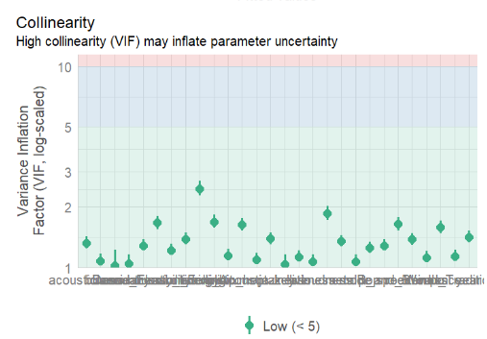
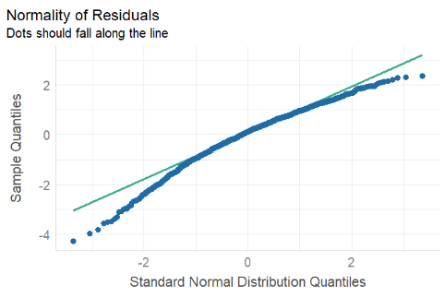
Data Challenge
Spotify top 2000 songs
Data Challenge
Spotify top 2000 songs
Data Challenge
Spotify top 2000 songs
Data Challenge
Spotify top 2000 songs
“Popularity” prediction
Linear Regression
About Us
About Us
About Us
Client requirements
Our Album
Our Album
Our Album
Dataset
Playlist
Playlist
Playlist
Data Cleaning
Artists
Artists
Artists
Exploratory analysis
Podcasts & Shows
Podcasts & Shows
Podcasts & Shows
“Popularity” prediction
Your Library
Your Library
Your Library
“Explicit” prediction
Trending
Trending
Trending
Summary of results
Help
Help
Help
Report History
Report History
Report History

Slide 20
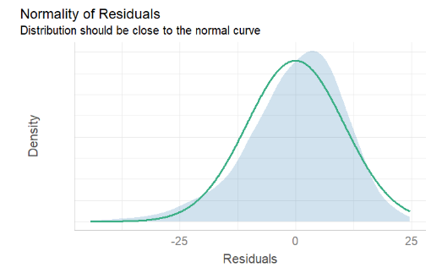
Data Challenge
Spotify top 2000 songs
Data Challenge
Spotify top 2000 songs
Data Challenge
Spotify top 2000 songs
Data Challenge
Spotify top 2000 songs
“Popularity” prediction
Linear Regression
About Us
About Us
About Us
Client requirements
Our Album
Our Album
Our Album
Dataset
Playlist
Playlist
Playlist
Data Cleaning
Artists
Artists
Artists
Exploratory analysis
Podcasts & Shows
Podcasts & Shows
Podcasts & Shows
“Popularity” prediction
Your Library
Your Library
Your Library
“Explicit” prediction
Trending
Trending
Trending
Summary of results
Help
Help
Help
Report History
Report History
Report History

Slide 21
Data Challenge
Spotify top 2000 songs
Data Challenge
Spotify top 2000 songs
Data Challenge
Spotify top 2000 songs
Data Challenge
Spotify top 2000 songs
“Popularity” prediction
Linear Regression
About Us
About Us
About Us
Client requirements
Our Album
Our Album
Our Album
Dataset
Playlist
Playlist
Playlist
RMSE: 10.0363061
RSQ: 0.1658812
MAE: 7.9951019
Data Cleaning
Artists
Artists
Artists
Exploratory analysis
Podcasts & Shows
Podcasts & Shows
Podcasts & Shows
“Popularity” prediction
Your Library
Your Library
Your Library
“Explicit” prediction
Trending
Trending
Trending
Summary of results
Help
Help
Help
Report History
Report History
Report History

Slide 22
Data Challenge
Spotify top 2000 songs
Data Challenge
Spotify top 2000 songs
Data Challenge
Spotify top 2000 songs
Data Challenge
Spotify top 2000 songs
“Popularity” prediction
Lasso Regression
About Us
About Us
About Us
Client requirements
Our Album
Our Album
Our Album
Dataset
Distributes the weights
Performs feature selection (weight 0 assigned to features if useless)
Tune L1 penalty
RMSE: 10.221164
RSQ: 0.163020
MAE: 8.213808
Playlist
Playlist
Playlist
Data Cleaning
Artists
Artists
Artists
Exploratory analysis
Podcasts & Shows
Podcasts & Shows
Podcasts & Shows
“Popularity” prediction
Your Library
Your Library
Your Library
“Explicit” prediction
Trending
Trending
Trending
Summary of results
Help
Help
Help
Report History
Report History
Report History

Slide 23
Data Challenge
Spotify top 2000 songs
Data Challenge
Spotify top 2000 songs
Data Challenge
Spotify top 2000 songs
Data Challenge
Spotify top 2000 songs
“Popularity” prediction
Ridge Regression
About Us
About Us
About Us
Client requirements
Our Album
Our Album
Our Album
Dataset
Presence of linear relations between predictor variables (confusion matrix)
Tune L2 penalty
RMSE: 10.0246504
RSQ: 0.1670626
MAE: 7.9984632
Playlist
Playlist
Playlist
Data Cleaning
Artists
Artists
Artists
Exploratory analysis
Podcasts & Shows
Podcasts & Shows
Podcasts & Shows
“Popularity” prediction
Your Library
Your Library
Your Library
“Explicit” prediction
Trending
Trending
Trending
Summary of results
Help
Help
Help
Report History
Report History
Report History

Slide 24
Data Challenge
Spotify top 2000 songs
Data Challenge
Spotify top 2000 songs
Data Challenge
Spotify top 2000 songs
Data Challenge
Spotify top 2000 songs
“Popularity” prediction
Decision Tree Regression
About Us
About Us
About Us
Client requirements
Our Album
Our Album
Our Album
Dataset
Decision Tree Regression
catches non-linear relationships between predictors and target
interpretability
RMSE: 10.50952401
RSQ: 0.09577053
MAE: 8.43666194
Playlist
Playlist
Playlist
Data Cleaning
Artists
Artists
Artists
Exploratory analysis
Podcasts & Shows
Podcasts & Shows
Podcasts & Shows
“Popularity” prediction
Your Library
Your Library
Your Library
“Explicit” prediction
Trending
Trending
Trending
Summary of results
Help
Help
Help
Report History
Report History
Report History

Slide 25
Data Challenge
Spotify top 2000 songs
Data Challenge
Spotify top 2000 songs
Data Challenge
Spotify top 2000 songs
Data Challenge
Spotify top 2000 songs
“Popularity” prediction
Random Forest Regression
About Us
About Us
About Us
Client requirements
Our Album
Our Album
Our Album
Dataset
Same reason as Decision Trees
Usually the best performing
RMSE: 10.198060
RSQ: 0.143808
MAE: 8.160378
Playlist
Playlist
Playlist
Data Cleaning
Artists
Artists
Artists
Exploratory analysis
Podcasts & Shows
Podcasts & Shows
Podcasts & Shows
“Popularity” prediction
Your Library
Your Library
Your Library
“Explicit” prediction
Trending
Trending
Trending
Summary of results
Help
Help
Help
Report History
Report History
Report History

Slide 26
“Popularity” prediction
Pre-processing for classification task
Data Challenge
Spotify top 2000 songs
Data Challenge
Spotify top 2000 songs
Data Challenge
Spotify top 2000 songs
Data Challenge
Spotify top 2000 songs
About Us
About Us
About Us
Client requirements
Our Album
Our Album
Our Album
Dataset
Playlist
Playlist
Playlist
Removed “artist” & “song”
75/25 train/test
strata = explicit (highly imbalanced data)
Standardization applied on all numerical features
Classification recipe
Data Cleaning
Artists
Artists
Artists
Exploratory analysis
Podcasts & Shows
Podcasts & Shows
Podcasts & Shows
“Popularity” prediction
“Explicit” prediction
Your Library
Your Library
Your Library
Trending
Trending
Trending
Summary of results
Help
Help
Help
Report History
Report History
Report History

Slide 27
Data Challenge
Spotify top 2000 songs
“Explicit” prediction
Logistic Regression
Data Challenge
Spotify top 2000 songs
Data Challenge
Spotify top 2000 songs
Data Challenge
Spotify top 2000 songs
About Us
About Us
About Us
Client requirements
Our Album
Our Album
Our Album
Dataset
Accuracy: 0.8194444
Kap: 0.5212004
F-score: 0.6451613
Playlist
Playlist
Playlist
Data Cleaning
Artists
Artists
Artists
Exploratory analysis
Podcasts & Shows
Podcasts & Shows
Podcasts & Shows
“Popularity” prediction
Your Library
Your Library
Your Library
“Explicit” prediction
Trending
Trending
Trending
Summary of results
Help
Help
Help
Report History
Report History
Report History

Slide 28
Data Challenge
Spotify top 2000 songs
“Explicit” prediction
Linear Discriminant Analysis
Data Challenge
Spotify top 2000 songs
Data Challenge
Spotify top 2000 songs
Data Challenge
Spotify top 2000 songs
About Us
About Us
About Us
Client requirements
Our Album
Our Album
Our Album
Dataset
Accuracy: 0.8287037
Kap: 0.5505567
F-score: 0.6451613
Playlist
Playlist
Playlist
Data Cleaning
Artists
Artists
Artists
Exploratory analysis
Podcasts & Shows
Podcasts & Shows
Podcasts & Shows
“Popularity” prediction
Your Library
Your Library
Your Library
“Explicit” prediction
Trending
Trending
Trending
Summary of results
Help
Help
Help
Report History
Report History
Report History

Slide 29
Data Challenge
Spotify top 2000 songs
“Explicit” prediction
Random Forest Classification
Data Challenge
Spotify top 2000 songs
Data Challenge
Spotify top 2000 songs
Data Challenge
Spotify top 2000 songs
About Us
About Us
About Us
Client requirements
Our Album
Our Album
Our Album
Dataset
Accuracy: 0.8217593
Kap: 0.5285982
F-score:
Playlist
Playlist
Playlist
Data Cleaning
Artists
Artists
Artists
Exploratory analysis
Podcasts & Shows
Podcasts & Shows
Podcasts & Shows
“Popularity” prediction
Your Library
Your Library
Your Library
“Explicit” prediction
Trending
Trending
Trending
Summary of results
Help
Help
Help
Report History
Report History
Report History

Slide 30
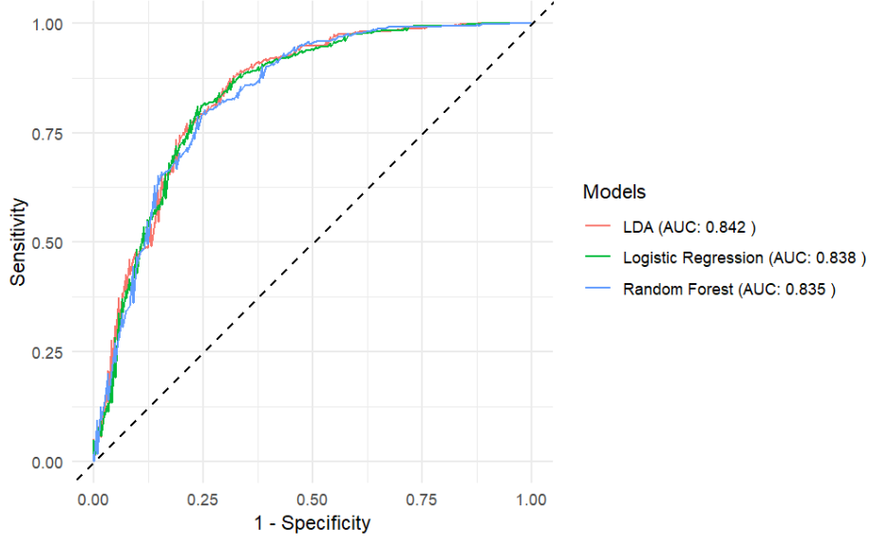
Data Challenge
Spotify top 2000 songs
“Explicit” prediction
ROC Curves
Data Challenge
Spotify top 2000 songs
Data Challenge
Spotify top 2000 songs
Data Challenge
Spotify top 2000 songs
About Us
About Us
About Us
Client requirements
Our Album
Our Album
Our Album
Dataset
Playlist
Playlist
Playlist
Data Cleaning
Artists
Artists
Artists
Exploratory analysis
Podcasts & Shows
Podcasts & Shows
Podcasts & Shows
“Popularity” prediction
Your Library
Your Library
Your Library
“Explicit” prediction
Trending
Trending
Trending
Summary of results
Help
Help
Help
Report History
Report History
Report History

Slide 31
Data Challenge
Spotify top 2000 songs
Data Challenge
Spotify top 2000 songs
Data Challenge
Spotify top 2000 songs
Data Challenge
Spotify top 2000 songs
Summary of results
About Us
About Us
About Us
Client requirements
Our Album
Our Album
Our Album
Dataset
Playlist
Playlist
Playlist
Data Cleaning
Artists
Artists
Artists
Exploratory analysis
Podcasts & Shows
Podcasts & Shows
Podcasts & Shows
“Popularity” prediction
Your Library
Your Library
Your Library
“Explicit” prediction
Trending
Trending
Trending
Summary of results
Help
Help
Help
Report History
Report History
Report History

Slide 32

Thank You!
Questions are welcome :)

